Slide 1

WELCOME TO GENERAL ASSEMBLY
Notes:
Good evening! I’d like to welcome everyone to General Assembly for (class name). How’s everybody doing?
Introduce yourself
By show of hands, how many of you are familiar with General Assembly? (look around the room and thank those for coming back to General Assembly) Welcome back and welcome to everyone who is on campus for their first time!

Slide 2
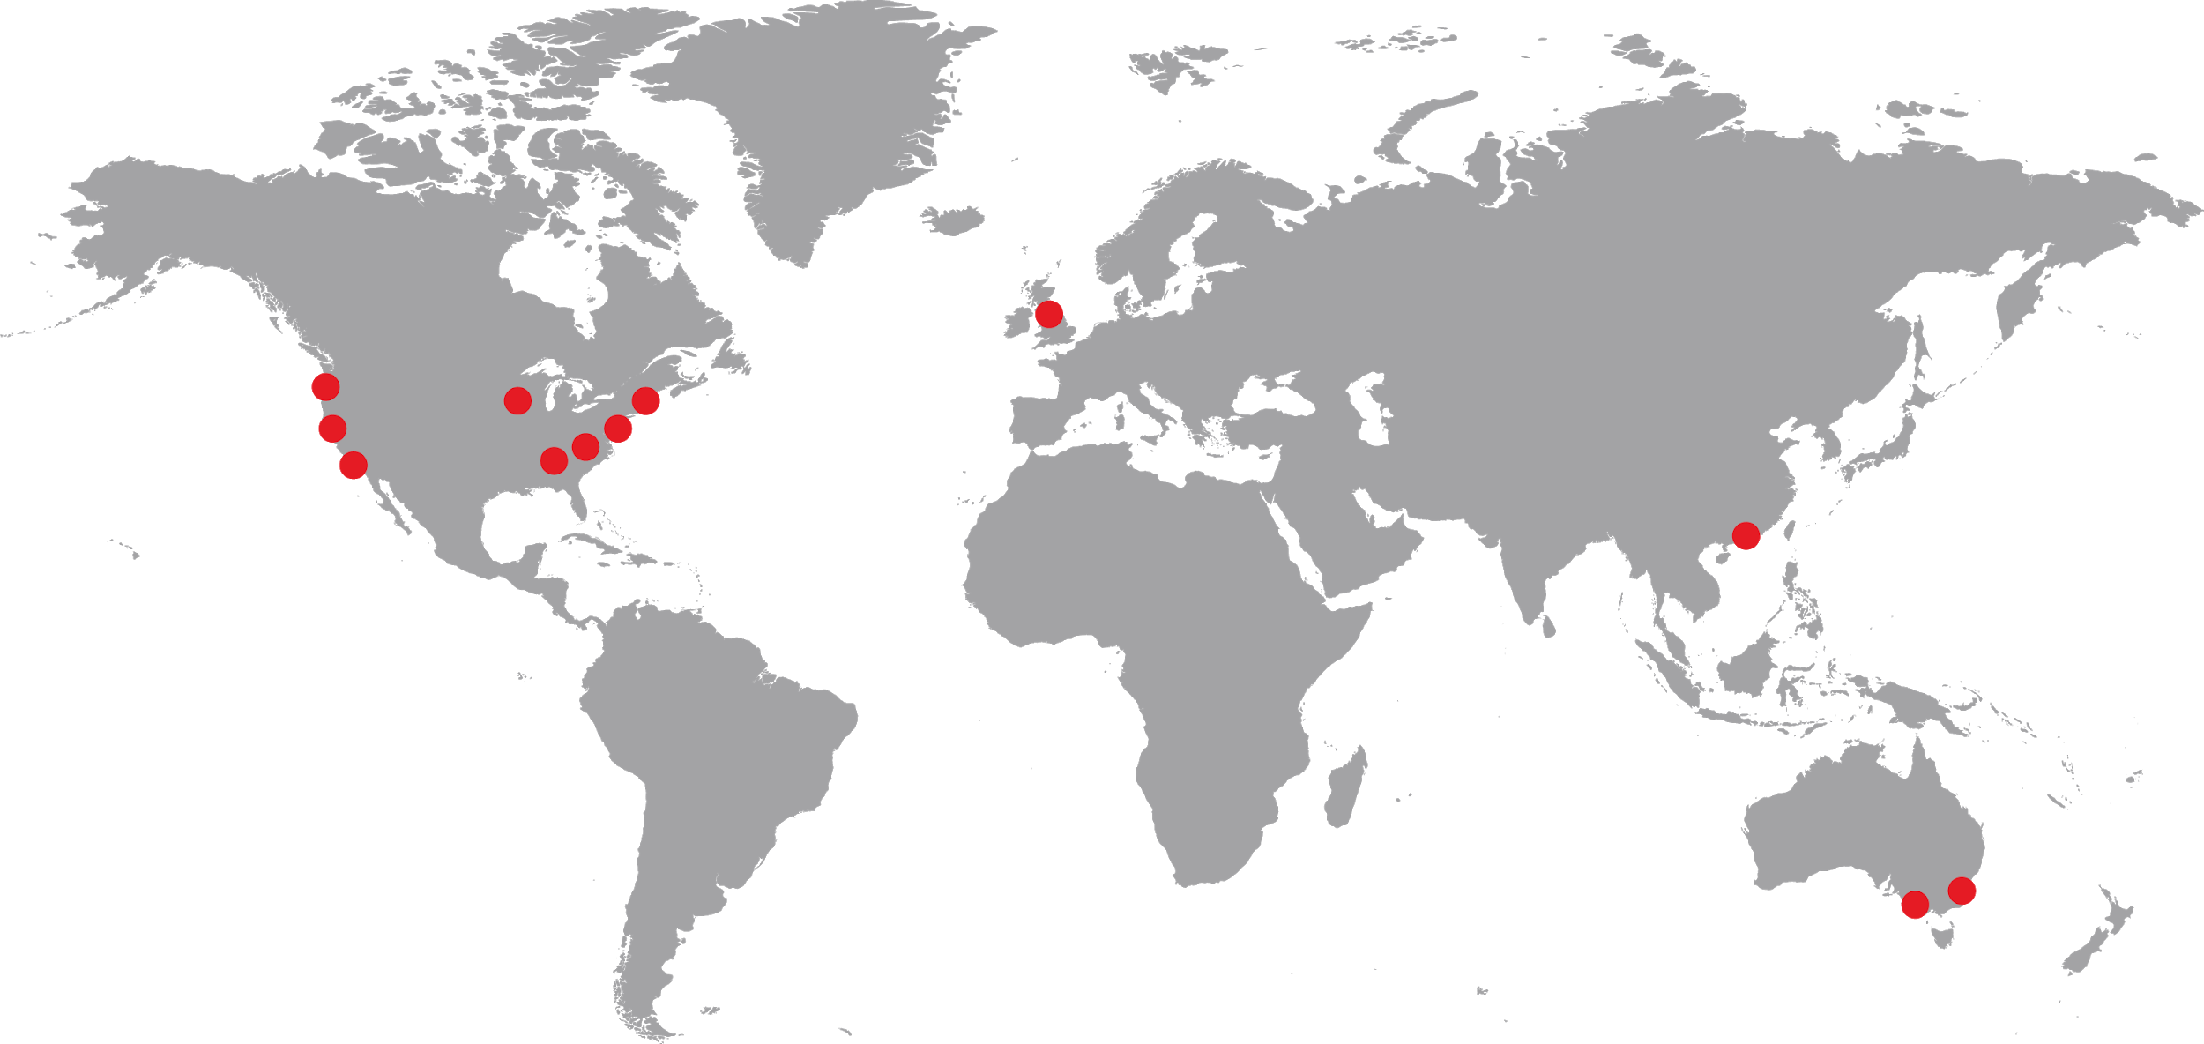
Notes:
General Assembly - “GA” - is a global education institution that specializes in the most in-demand skills across data, design, technology and business. We have campuses like this one in 14 other cities around the world, where we empower a global community to pursue work they love
We offer classes, workshops, and courses in development, design, digital marketing, data science, and business with a range of commitment options
As part of helping individuals like yourselves acquire new skills and/or transition into a new career, we also work with employers as a source of talent. In fact, more than 2500 employers have hired our grads of our full-time, immersive courses!

Slide 3
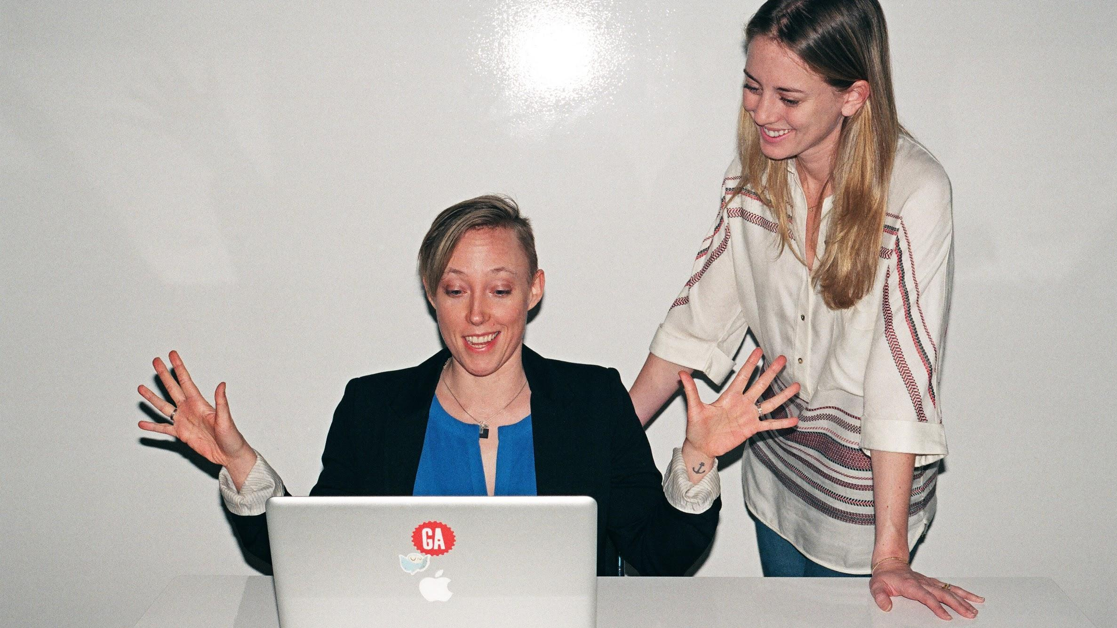

Let’s get started...
General Assembly
Notes:
[switch to lesson slides]

Slide 4
INTRODUCTION TO DATA SCIENCE
Daniel Payne

Slide 5
INTRODUCTION TO DATA SCIENCE
AGENDA
What Is Data Science?
How Is Data Science Used?
Getting Started with Data Science
Questions and Next Steps

Slide 6
INTRODUCTION TO DATA SCIENCE
WHAT IS DATA SCIENCE?

Slide 7

What is Data Science???
Why do I have this picture here?
Who is it?
What movie is it??
Notes:
Billy Beane challenged the norm and the statistics that were used by the industry.
Something similar has happened recently with the classification of cancer.

Slide 8
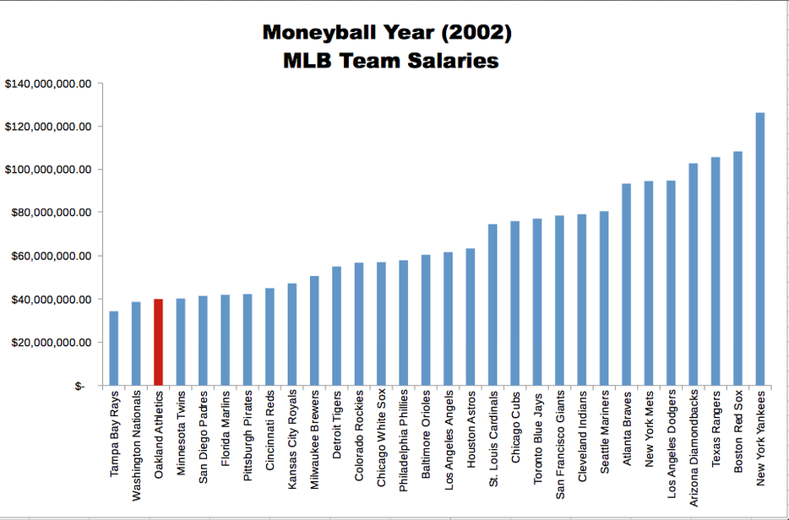
What is Data Science???
Although the Oakland A’s didn’t win the world series, they changed the way baseball was analysed forever.

Slide 9
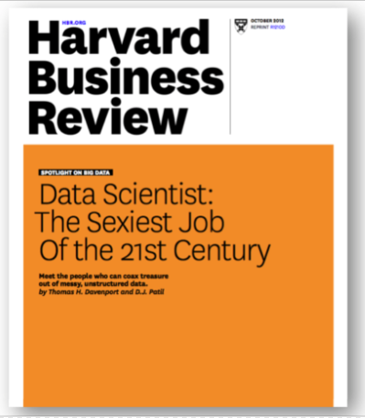
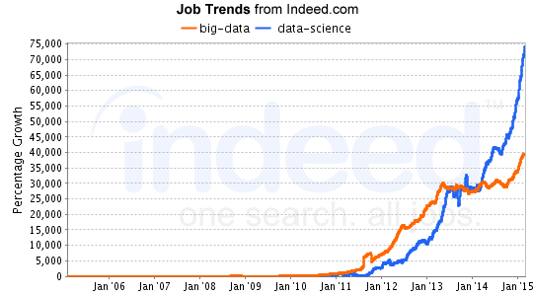
WHAT IS DATA SCIENCE?

Slide 10
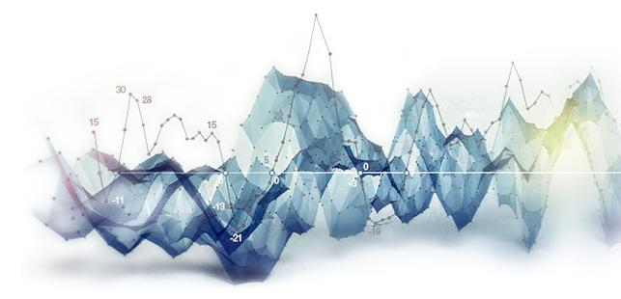
WHAT IS DATA SCIENCE?
THE OFFICIAL ANSWER
A set of tools and techniques used to extract useful information from data
An interdisciplinary, problem-solving-oriented subject
The application of scientific techniques to practical problems
A rapidly-growing field

Slide 11
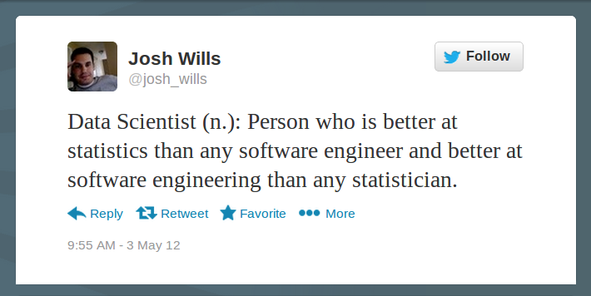
WHAT IS DATA SCIENCE?

Slide 12
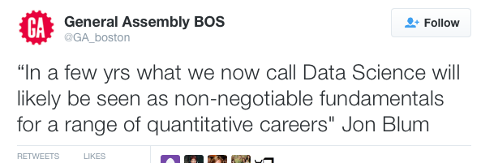
WHAT IS DATA SCIENCE?

Slide 13
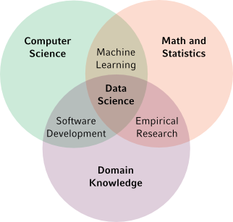
WHAT IS DATA SCIENCE?
BY FIELD

Slide 14
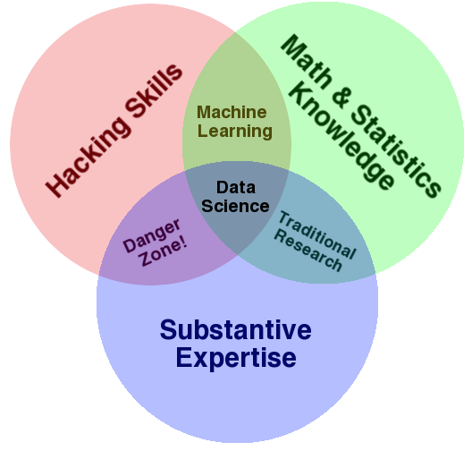

WHAT IS DATA SCIENCE?
BY SKILL
Communication
Notes:
Why do I have Danger Zone written here?
Without the requisite understanding of some of the maths can results in catastrophic error (e.g. taking an average of averages which is a bad mistake)

Slide 15
WHAT IS DATA SCIENCE?
Scripting
Languages
Data Storage
Systems
Visualization
Tools
Distributed
Systems
Tech Skills
Database
Systems
Machine
Learning
Algorithms
Data Analysis Tools

Slide 16
WHAT IS DATA SCIENCE?
STORYTELLING METHODOLOGY
My understanding of the business problem
How I will measure the business impact
What data is available
The initial solution hypothesis
The solution
The business impact of the solution
– George Roumeliotis Intuit, Walmart

Slide 17
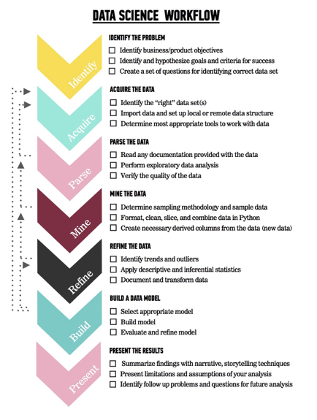
WHAT IS DATA SCIENCE?
DATA SCIENCE WORKFLOW
Identify the problem
Acquire the data
Parse the data
Mine the data
Refine the data
Build a data model
Present the results

Slide 18
WHAT IS DATA SCIENCE?
IDENTIFY
Why are you doing this in the first place?
Who are the stakeholders?
What data will you need?
How will you define success?

Slide 19
WHAT IS DATA SCIENCE?
ACQUIRE
Is the data you need available to you?
How is it stored? Relational database, NoSQL datastore, files
Is is public or proprietary?
Can it be supplemented?
What tools will you need to import it?
What tools will you need to work with it?

Slide 20
WHAT IS DATA SCIENCE?
PARSE
What documentation is available, if any? (People count as documentation.)
Were you able to import the data?
What did you learn from initial exploratory analysis?
Is the data, in fact, sufficient?
How much munging will it require?

Slide 21
WHAT IS DATA SCIENCE?
MINE
What sampling methodology will you use? WRANGLING/MUNGING/MINING (…80% of work occurs here…)
What secondary features need to be derived?

Slide 22
WHAT IS DATA SCIENCE?
REFINE
What new trends appear?
Any notable outliers?
Notable results from applying derived features?
Are you documenting your approach?

Slide 23
WHAT IS DATA SCIENCE?
MODEL
What model or models are most appropriate for the data and the problem?
Is the data in the appropriate format for the desired model(s)?
How did the initial model perform?
Any symptoms of over-fitting?

Slide 24
WHAT IS DATA SCIENCE?
PRESENT
What narrative do I want to tell?
What assumptions are we making?
What inherent limitations should be disclosed?
Were the criteria for success met?
What are the next steps?

Slide 25
WHAT IS DATA SCIENCE?
(DEPLOY)
What changes need to be made to run the model in production?
Can the model handle real-time data?
Will the model need to be retrained? How often?
Does the deployment team have the context to satisfy the original intent?

Slide 26
INTRODUCTION TO DATA SCIENCE
HOW IS DATA SCIENCE USED?

Slide 27










HOW IS DATA SCIENCE USED? Who uses it?

Slide 28

HOW IS DATA SCIENCE USED?
NETFLIX PROGRAMMING DECISIONS
Features: When user watches and for how long Where and on what device the user is watching Rewinds, pauses, fast-forwards
Same categorization for current programming used to determine new content (Animated / Comedy / 18-29 / Cynical / 30 min / etc.)

Slide 29

HOW IS DATA SCIENCE USED?
“TARGET KNEW I WAS PREGNANT”
DS team analyzed buying patterns of women on baby registries
Trends emerged: Specific lotions and vitamins in 2nd trimester Switch to scent-free products in 3rd trimester Colored items signifying gender
Marketing team used this data to send coupons
Some family surprises…

Slide 30
HOW IS DATA SCIENCE USED?
Evolution of Data Creation
Every two days, we create more information than we did up to 2003. This is about 2 exabytes (2 billion gigabytes)
Creation of data outstrips capabilities to store it.
Hardware costs coming down but also cloud computing has made it possible for everyone to use IT infastructure.
Source : https://www.economist.com/special-report/2010/02/25/data-data-everywhere
Notes:
Apparently all the words ever spoken would occupy 5 exabytes of Data!!!

Slide 31
HOW IS DATA SCIENCE USED?
What is Big Data??
It describes Data that:
Doesn’t fit into memory
Doesn’t fit on a machine
Notes:
Think of an example?
Well Bank Data covers this. Highly secure, needs to be accessed quickly and there is a lot of it!!!

Slide 32
HOW IS DATA SCIENCE USED?
Big Data – A Cautionary Tale

Slide 33
HOW IS DATA SCIENCE USED?
Big Data – A Cautionary Tale
Notes:
The Poll predicted that Roosevelt would have 43% of vote.
In fact he won in a landslide of 60% of the vote!

Slide 34
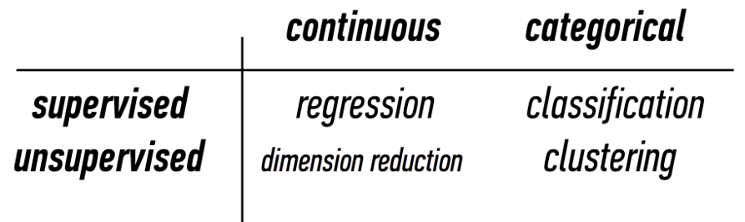
HOW IS DATA SCIENCE USED?
MACHINE LEARNING PROBLEMS

Slide 35
HOW IS DATA SCIENCE USED?
TWO AXES
Output: Continuous vs. Categorical
Problem: Supervised vs. Unsupervised

Slide 36
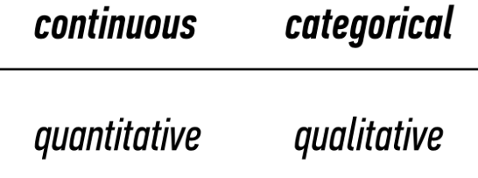
HOW IS DATA SCIENCE USED?
CONTINUOUS VS. CATEGORICAL

Slide 37
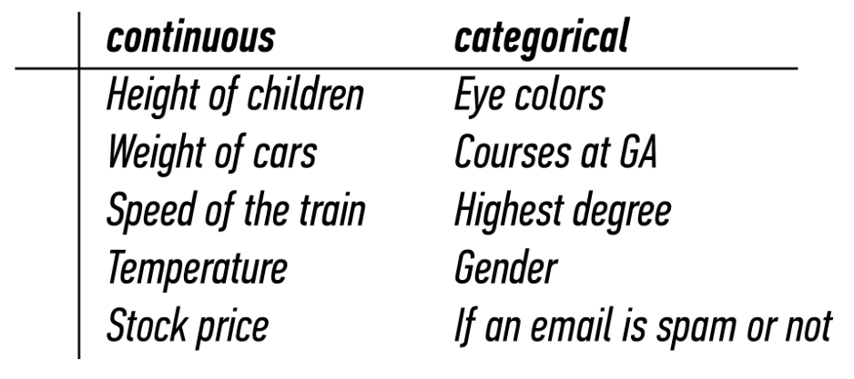
HOW IS DATA SCIENCE USED?
CONTINUOUS VS. CATEGORICAL

Slide 38
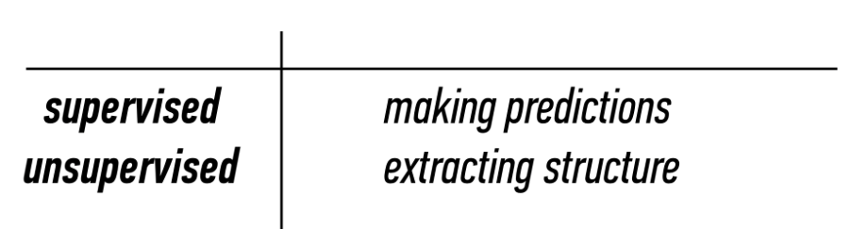
HOW IS DATA SCIENCE USED?
SUPERVISED VS. UNSUPERVISED
Supervised: Generalization
Unsupervised: Representation

Slide 39
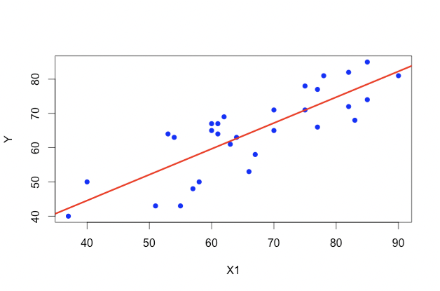
HOW IS DATA SCIENCE USED?
Type of learning Problem - Supervised
Supervised problems are ones where you can look for trends within the data.
This will allow you to make predictions regarding the output of your data

Slide 40
HOW IS DATA SCIENCE USED?
FEATURES
Functions: values in, value out
y = f(x₁, x₂, x₃…)
x: independent variable(s) (input)
y: dependent variable (output)
y can be specific value, binary Yes/No, 0 to 1 confidence, categories…
Other names for x: predictor, regressor, explanatory variable, feature
Other names for y: response, regressand, explained variable, outcome, label

Slide 41
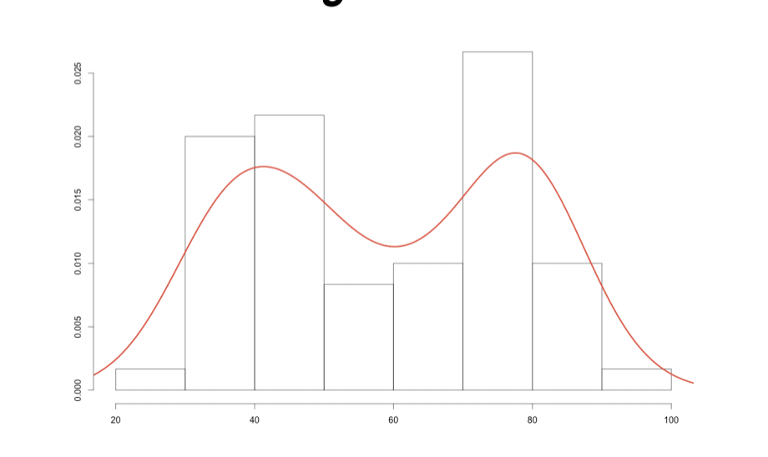
HOW IS DATA SCIENCE USED?
Type of learning Problem - Unsupervised
Unsupervised problems are ones where you want to extract some sort of structure from the data.
This will allow you to find commonality between groups.

Slide 42
HOW IS DATA SCIENCE USED?
MACHINE LEARNING PROBLEMS

Slide 43
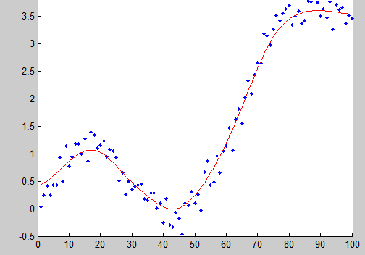
HOW IS DATA SCIENCE USED?
REGRESSION (CONTINUOUS, SUPERVISED)
Build a model that best fits data
You’ve probably done this before
Minimize error without overfitting
Predict a (continuous) value
Even Excel can do this! (“Add Trendline…”)
Linear regression, logistic regression…

Slide 44
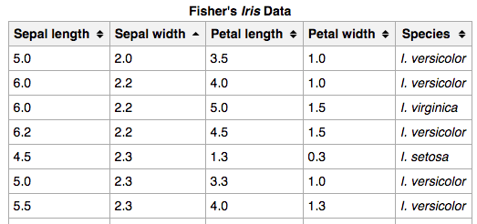
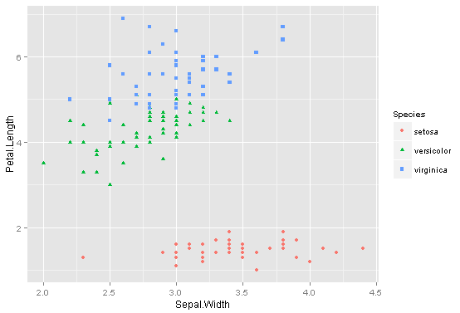
HOW IS DATA SCIENCE USED?
CLASSIFICATION (CATEGORICAL, SUPERVISED)
Map feature vectors to categorical target classes.
Ex: species of iris from petal/sepal sizes
K-Nearest Neighbors, Naïve Bayes, Random Forest…

Slide 45
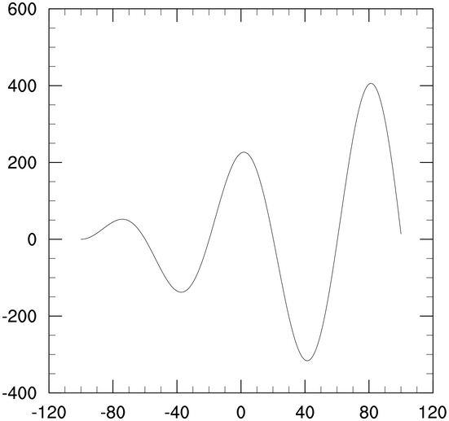
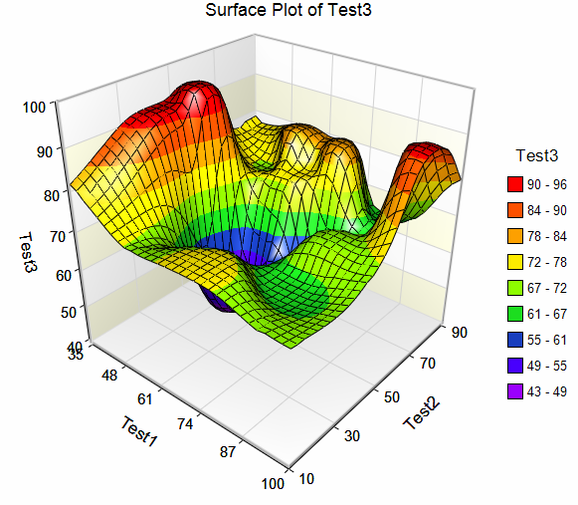
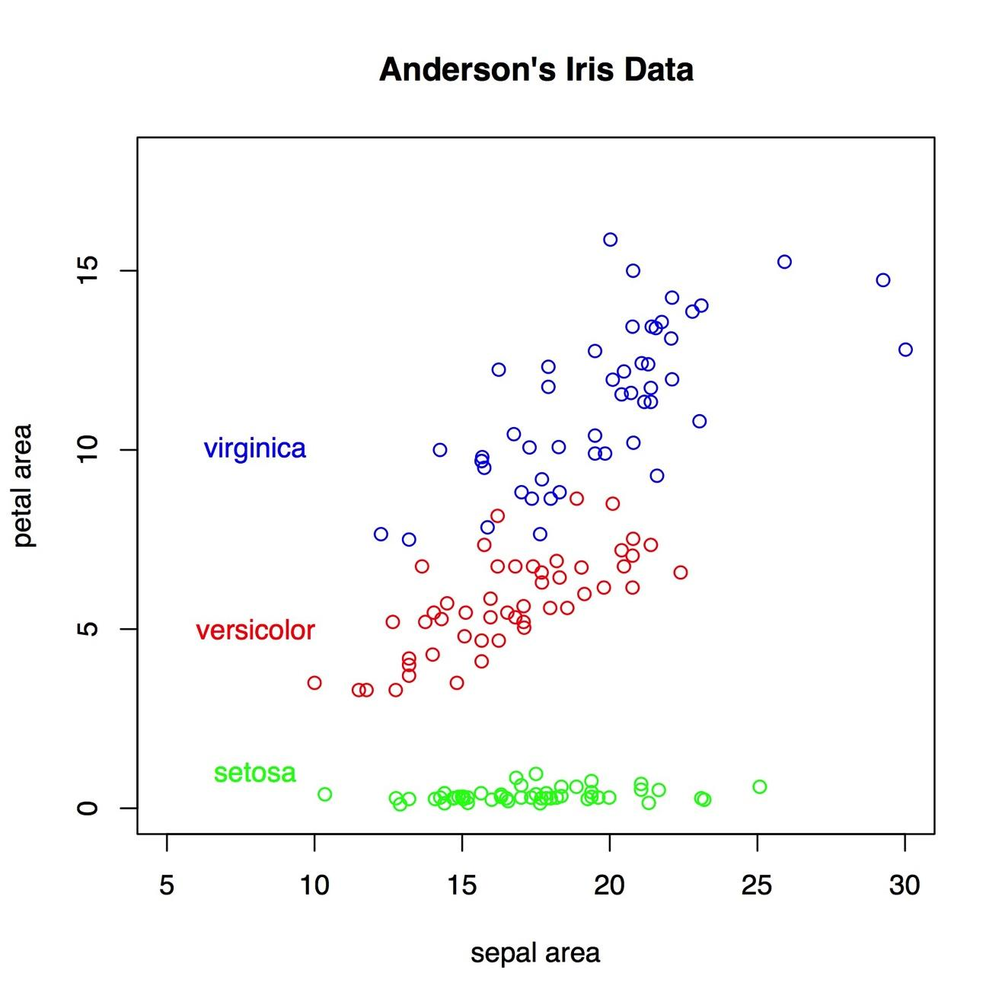
HOW IS DATA SCIENCE USED?
DIMENSIONALITY REDUCTION (CONTINUOUS, UNSUPERVISED)
Every new feature adds a dimension
Higher dimensions harder to visualize
More computationally intensive
Reduces multicolinearity
In short: collapse features
Correlated Ex: Mobile platform & browser
Derived Ex: petal/sepal area in iris dataset
Notes:
Maybe talk about the curse of high dimensionality?? Judge the class knowledge for that.

Slide 46
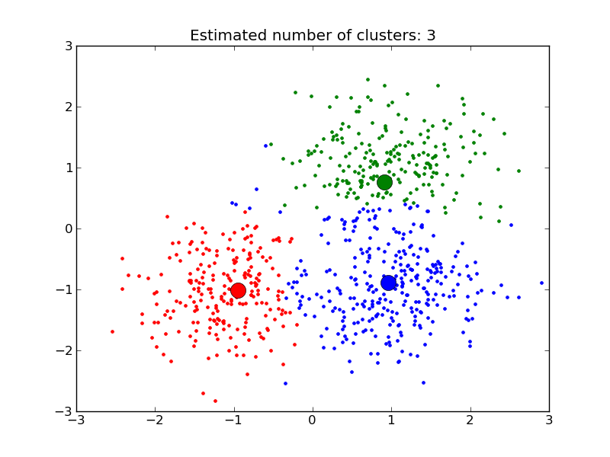
HOW IS DATA SCIENCE USED?
CLUSTERING
(CATEGORIAL, UNSUPERVISED)
Similar to classification, except no labels/classes provided
Purpose is representation – anything that helps you better understand the data
Finding common threads that a human couldn’t see (harder with higher dimensions)
K-Means, Density-Based, etc.

Slide 47
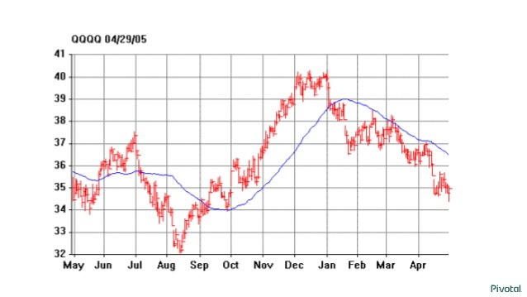
HOW IS DATA SCIENCE USED?
WHAT TYPE OF PROBLEM? – STOCK PRICES

Slide 48

HOW IS DATA SCIENCE USED?
WHAT TYPE OF PROBLEM? – MORTGAGE APPLICATION
Age
Gender
Annual salary
Years in job
Current debt
Credit score
…

Slide 49
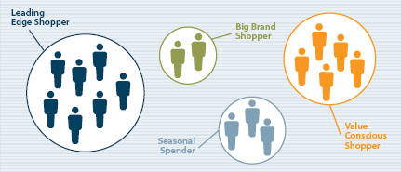
HOW IS DATA SCIENCE USED?
WHAT TYPE OF PROBLEM? – CUSTOMER SEG

Slide 50
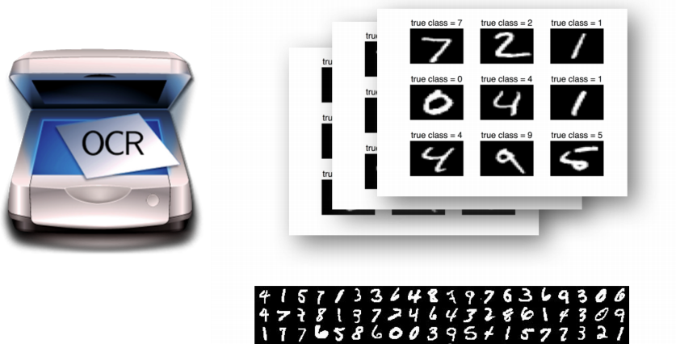
HOW IS DATA SCIENCE USED?
WHAT TYPE OF PROBLEM? – OCR

Slide 51
INTRODUCTION TO DATA SCIENCE
GETTING STARTED WITH DATA SCIENCE
(And the traits of a Data Scientist)

Slide 52
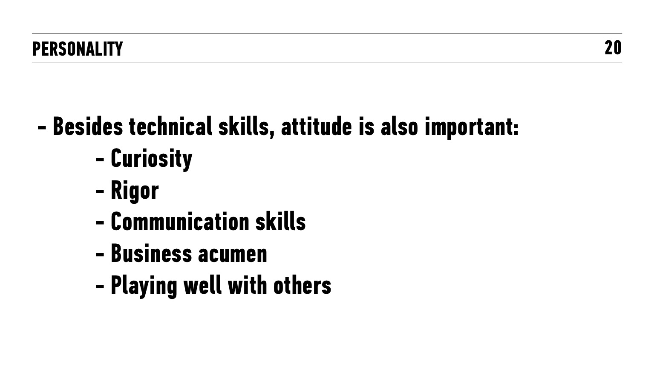

Slide 53
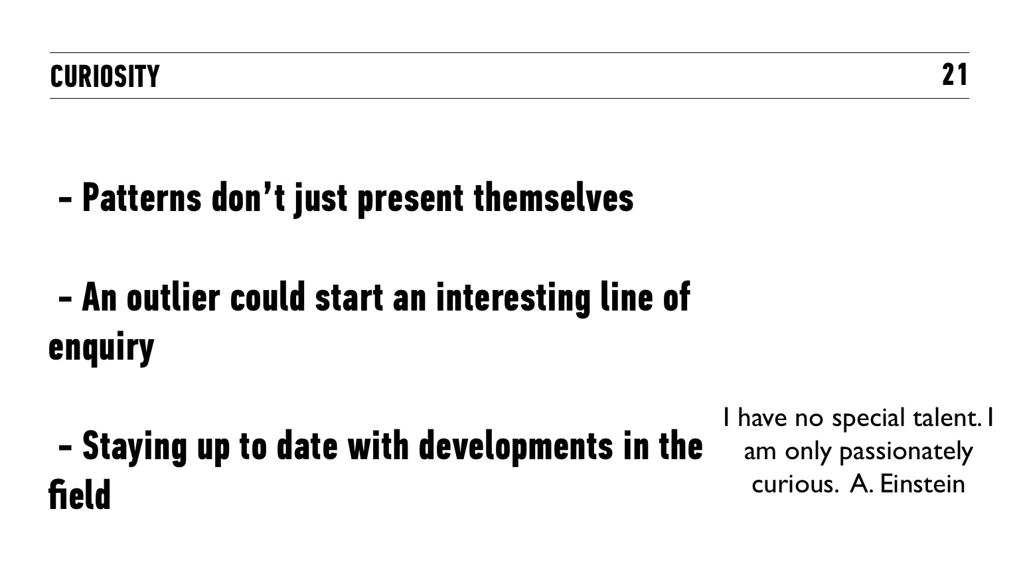

Slide 54
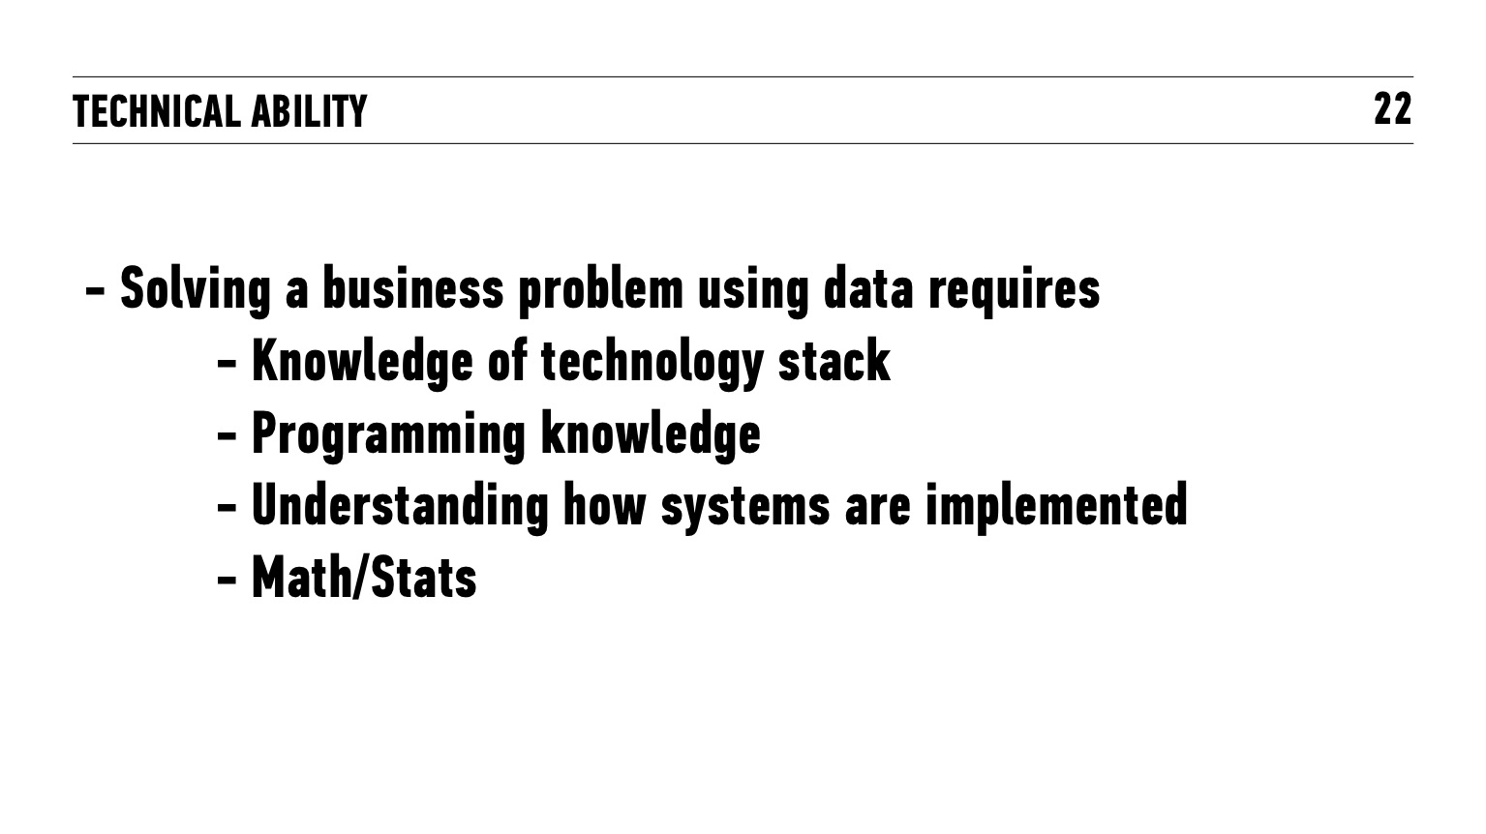

Slide 55
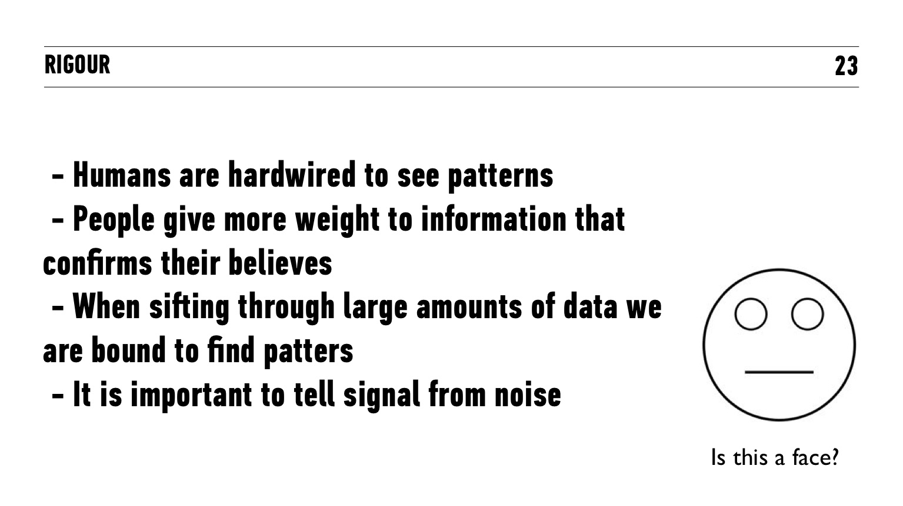

Slide 56
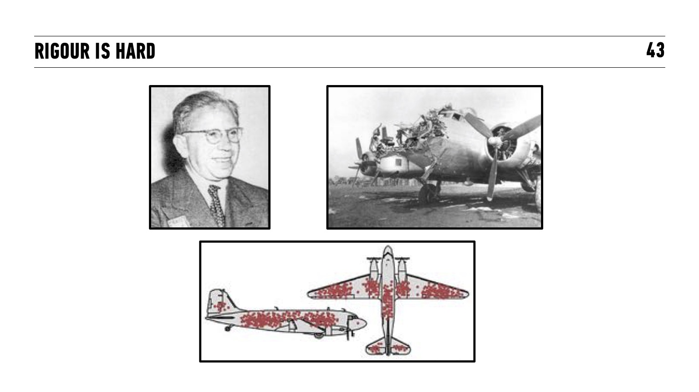
Notes:
Also mention Business Acumen, Working in Teams and Communication as traits of a Data scientist as well.

Slide 57
INTRODUCTION TO DATA SCIENCE
Tools of a Data Scientist

Slide 58
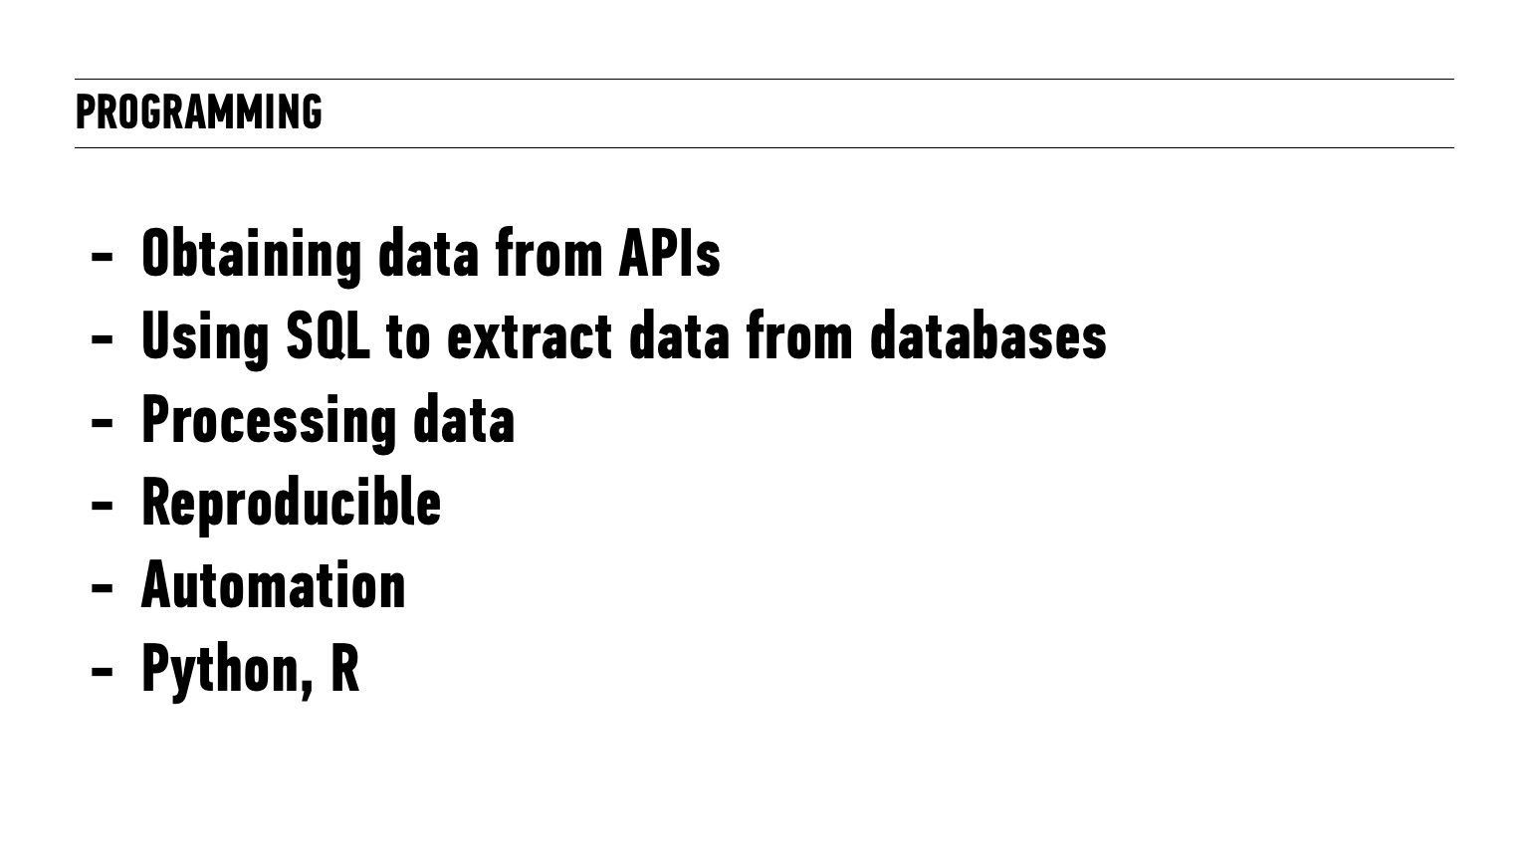

Slide 59
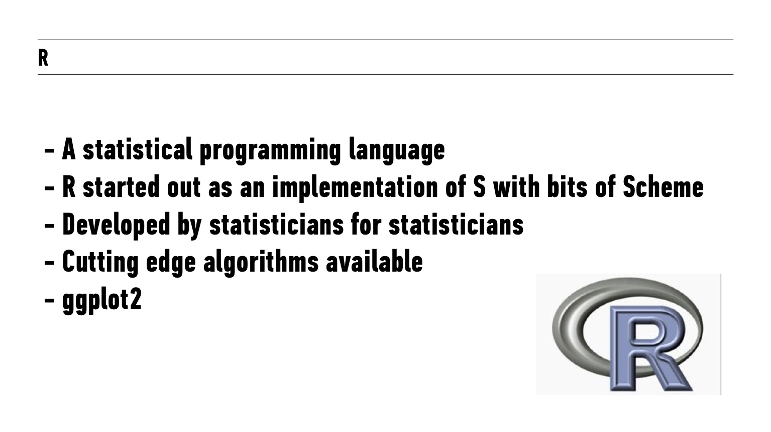

Slide 60
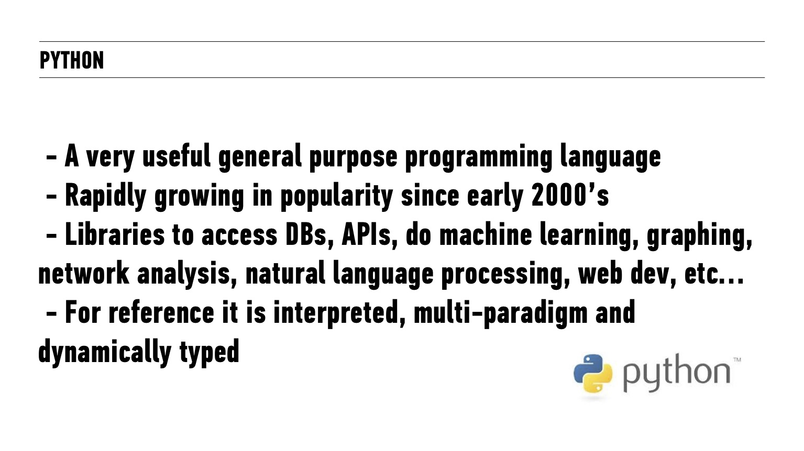

Slide 61
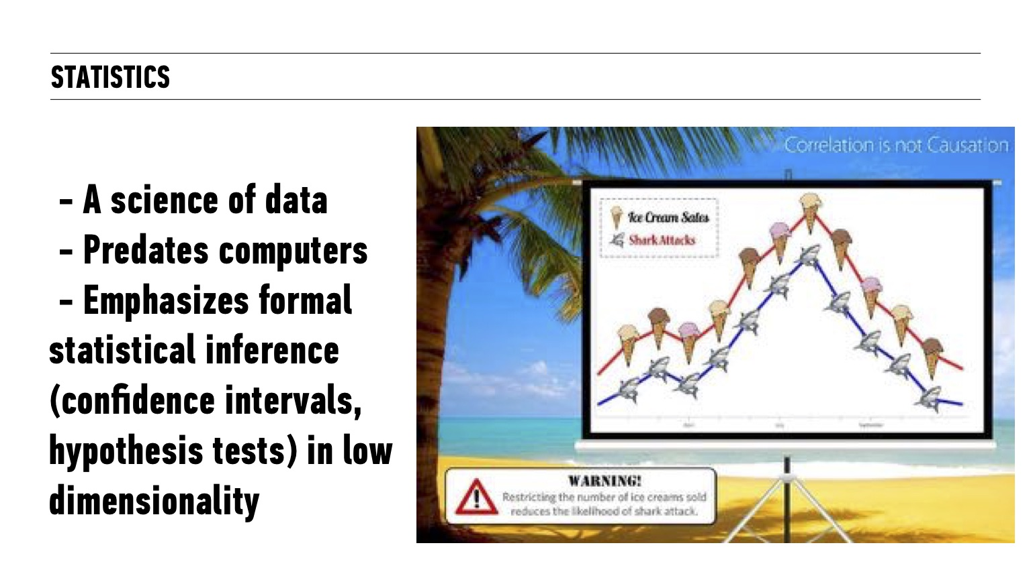

Slide 62
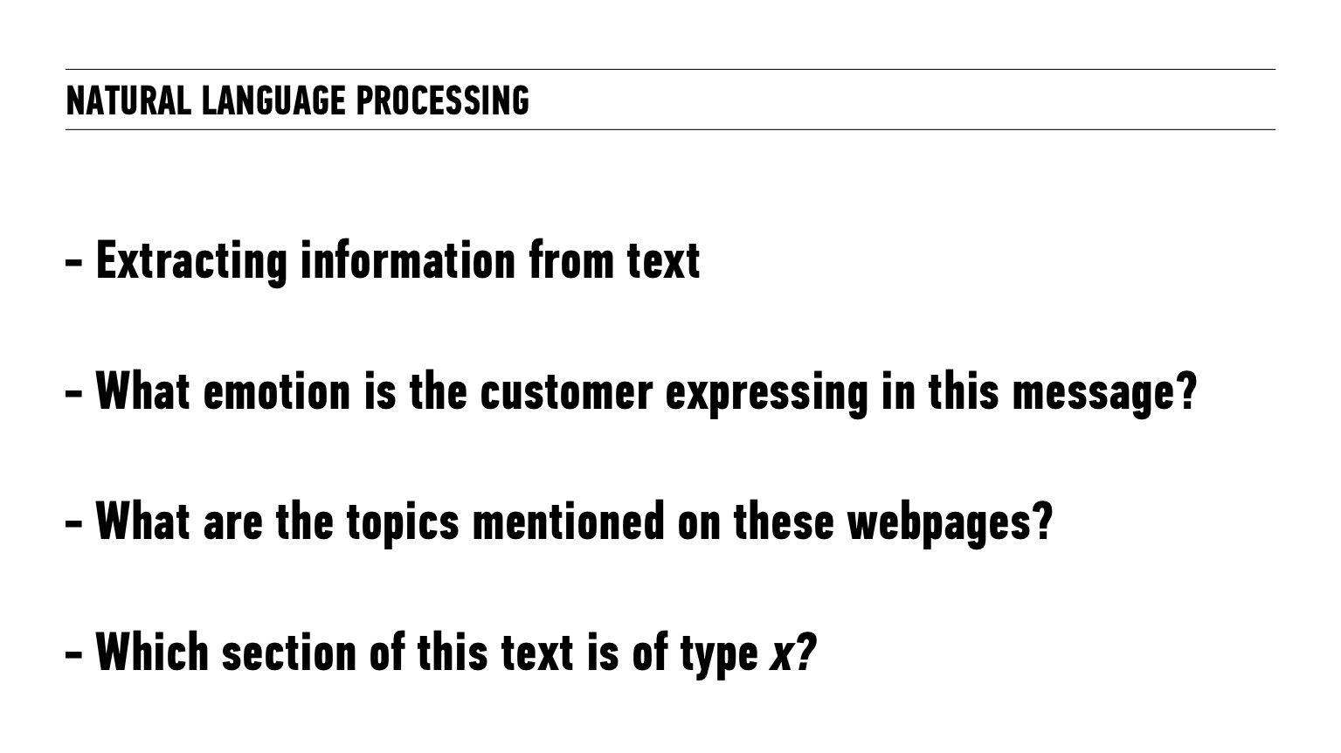

Slide 63
INTRODUCTION TO DATA SCIENCE
Continuing your Data Science Journey

Slide 64
GETTING STARTED WITH DATA SCIENCE
<GETTING STARTED DEMO>

Slide 65
We appreciate your feedback!
Please take 60 seconds to complete our survey.
www.ga.co/introclass
Notes:
KEEP OR DELETE THIS SLIDE DEPENDING DEPENDING ON DIGITAL OR PAPER SURVEY! Connect with your C&W producer on whether you run paper or digital surveys for Intro Classes!
Here are some best practices:
Regardless if Ask everyone to complete the survey prior to Q&A or final thoughts. Reasoning is that if you do Q&A/final thoughts, people check out mentally, or worse, leave. Having everyone to complete the survey prior to those items has worked really well. So moving that survey slide with the shortlink before Q&A or final thoughts is key.
Ask everyone to share their feedback and take 2-3 minutes to allow everyone to do so. Previous instructors have said something like, "This is a free class. The only thing we ask in return is your feedback so we can improve this workshop. Let's take 2-3 minutes to do that."
For digital survey only: Works on mobile too: Although the slide suggests it, it's good to verbally say that it works on mobile too.

Slide 67
INTRODUCTION TO DATA SCIENCE
WRAP-UP
What Is Data Science?
How Is Data Science Used?
Getting Started with Data Science
Questions and Next Steps

Slide 68
INTRODUCTION TO DATA SCIENCE
Q&A

